Slide 1
Safe Asynchronous Programming: Methodology, Language, and Tools
Introduction
PLDI 2019 Tutorials

Slide 2
Presenters

Slide 3
Tutorial Outline

Slide 4

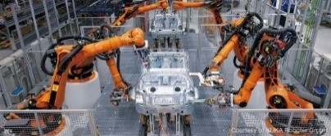


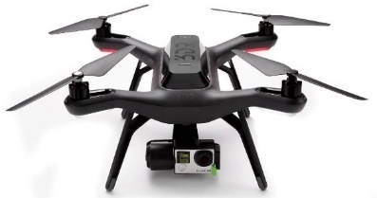

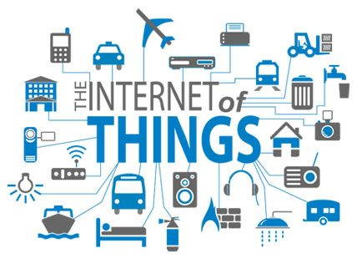
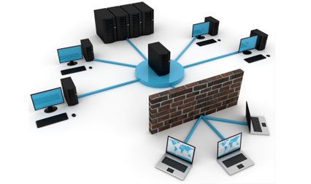
Event Driven Asynchronous Systems
Operating System, Device-Drivers, Web-Applications.
Industrial Automation, Robotic System, Cyber Physical Systems.
Distributed Systems, Distributed Storage.
Internet of Things.
Notes:
Most of the applications across domains are event-driven in nature consisting of processing communicating with each other by sending messages.
Device drivers in OS, web-app are event-driven.
Distributed systems by contruction are event-driven in nature as nodes communicate by sending messaging.
More recently, robotic applications are becoming more and more complex and are implemented as concurren event-driven systems.
To summarize, the paradigm of event-driven programming is becoming popular across domains as the applications are becoming more and more parallel and distributed in nature.

Slide 5
Characteristics of Event Driven Systems
Event-Driven Asynchronous System (actor model):
Collection of concurrently executing processes.
Processes can be created dynamically.
Processes communicate by asynchronously sending messages or events to each other.
Reactive Systems:
Processes in the system interact continuously with the environment.

Slide 6

Programming Event Driven Systems is Challenging
Non-determinism
Non-determinism
Sensor Failure
Node Failure
Uncertainties
Uncertainties
Fault Tolerance
Environment
Modeling
Fault Tolerance
Environment
Modeling
Message Loss
Message Loss
Reactivity
Reactivity
Safety
Specifications
Synchrony
Liveness!
Partial-Synchrony
Partial-Synchrony
Concurrency
Concurrency
Complex Interaction
Aynschrony
Composition
Multiple Components

Slide 7
Overview: P Framework
P Program
Implementation
Specification
Abstractions
Test
P Framework
P: State machine based programming language [PLDI 2013].
Modular P: Implements a module system for hierarchical and compositional reasoning [OOPSLA 2018].

Slide 8
Overview: P Framework
P Program
Implementation
Specification
Compiler
Toolchain
Abstractions
Test
Intermediate Code
Systematic
Testing
Tool
(Reproducible) Error Trace
P Framework
Scalable Analysis of Event-Driven Programs:
Reduction [OOPSLA 2014] [CAV 2015], Search Prioritization [FSE 2015], Symbolic Execution [in submission].

Slide 9
Overview: P Framework
P Program
Autogen C Impl.
Deployment
tool
Autogen Impl.
P
Runtime
Wrappers
Implementation
Wrappers
Specification
OS, Libs
Compiler
Toolchain
Abstractions
Target Platform
Test
Intermediate Code
Systematic
Testing
Tool
(Reproducible) Error Trace
P Framework
Build Safe Real-World Systems:
Windows Device Drivers (USB 3.0) [PLDI 2013, OOPSLA 2014]
Fault Tolerant Distributed Systems [Microsoft Azure, OOPSLA 2018].
Safe Robotic Systems [ICCPS 2017, RV 2017, ISoLA 2018]

Slide 10
Origin P (USB 3.0)

Slide 11
Teams that Used/Adapted P

Slide 12
Impact of P#

Slide 13
Learnings from P to P#

Slide 14
Positioning P and P#
Where does P position with respect to TLA and Mace.

